Slide 1

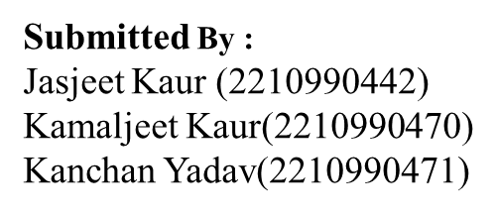
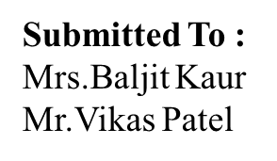
AirBnB (Clone)
Chitkara University Institute of Engineering and Technology,
Chitkara University, Punjab

Slide 2
Table of Contents
Introduction
Project Overview
Technical Details
Key Features
Project Highlights
Conclusion
References/Links used

Slide 3

Introduction
Overview:
Our project is a clone of the Airbnb website. You know, Airbnb helps people find places to stay when they travel. We tried to make a website UI that looks just like Airbnb, where you can look for places to stay and book them.
Purpose of the Project:
We made this project to learn how to use React. Also, we wanted to practice making websites to get better at it.

Slide 4
Project Overview
Our project is a website that looks and works just like Airbnb. Airbnb is a website where people can find homes to stay in when they travel. You can search for a place to stay, see pictures of it, and book it for your trip. Our website lets you do all those things too!
Why we chose AirBnB for project:
We picked Airbnb because it's a popular website that many people use. We thought it would be fun and useful to make a website that works like Airbnb. Also, Airbnb has a lot of cool features, so it's a good challenge for us to try to recreate them.

Slide 5
Technical Details
For building our website, we used a bunch of tools and technologies.
We used CSS to make things look nice and pretty. React JS helped us to build the website and make it work smoothly.
We also used Material UI and Ant Design libraries to add some cool features and styles.
To manage our data, we used JSON Server.
And to navigate between different pages on our website, we used React Router DOM.
These tools and technologies helped us create a website that's both functional and good-looking.

Slide 6
Key Features
Our Airbnb clone boasts a user-friendly page featuring five distinct categories, each offering a curated selection of eight places to stay.
Integrated calendar functionality simplifies the booking process, allowing users to select check-in and check-out dates.
Leveraging JSON server, our website fetches data, ensuring up-to-date listing and information.
React Router DOM, navigation between categories and individual listing is smooth and intuitive, providing users with a seamless browsing experience.

Slide 7
Project Highlights

Slide 9
Conclusion
In summary, our Airbnb clone is a testament to our dedication to web development knowledge. With intuitive navigation, seamless booking functionality, and dynamic data integration, we've created a user-friendly platform that emulates the original Airbnb experience. Leveraging modern technologies like React and JSON Server, we've built a responsive website that meets the needs of today's travelers. As we wrap up, we thank everyone involved and look forward to continued improvements. Thank you for your attention.

Slide 10

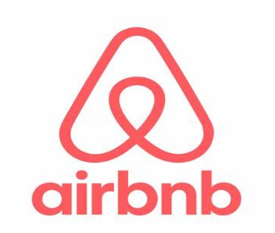

References/Links used
AirBnB: https://www.Airbnb.co.in
Ant Design Library: https://ant.design
Material UI Library: https://mui.com/material-ui

Slide 11
Git Repo & Deploy Site
GitHub Repository:
Netlify Deployment:

Slide 12


